Slide 1

7th Grade Math
Unit 8, Lesson 3 Exponential Expressions Volume 2, pg. 16

Slide 2


Benchmark
MA.7.NSO.1.1
Know and apply the Laws of Exponents to evaluate numerical expressions and generate equivalent numerical expressions, limited to whole-number exponents and rational number bases.
volume 2, pg. 16

Slide 3
Integrated Mathematical Thinking and Reasoning Standards
MA.K12.MTR.1.1 Actively participate in effortful learning both individually and collectively.
MA.K12.MTR.3.1 Complete tasks with mathematical fluency.
MA.K12.MTR.4.1 Engage in discussions that reflect on the mathematical thinking of self and others.
MA.K12.MTR.5.1 Use patterns and structure to help understand and connect mathematical concepts.
MA.K12.MTR.6.1 Assess the reasonableness of solutions.
volume 2, pg. 16

Slide 4

Learning Targets
I can evaluate numeric expressions with the same base using the laws of exponents.
I can generate equivalent numeric expressions by applying the laws of exponents.
volume 2, pg. 16

Slide 5

Warm-Up
volume 2, pg. 16

Slide 6
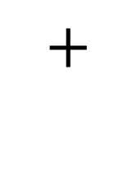

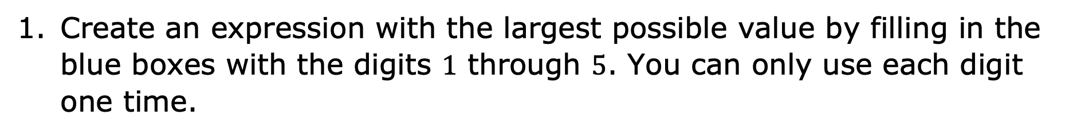
8.3.1 Warm-Up: Make an Expression
Create an expression with the largest possible value by filling in the blue boxes with the digits $1$ through $5$. You can only use each digit one time.
volume 2, pg. 16

Slide 7

Collaboration
volume 2, pg. 17

Slide 8

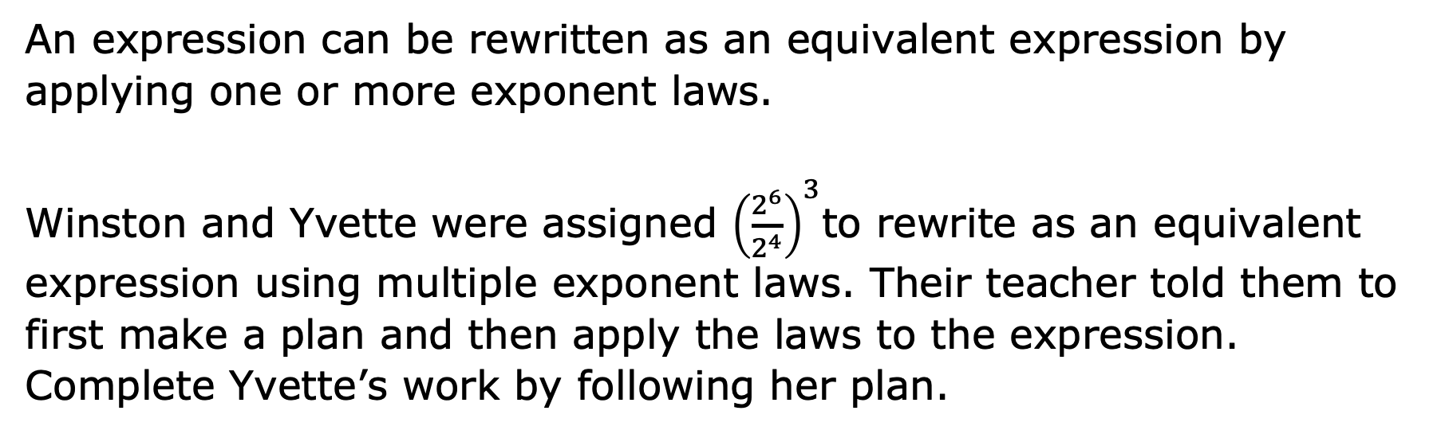
8.3.2 Collaboration: Applying More Than One Exponent Law
An expression can be rewritten as an equivalent expression by applying one or more exponent laws.
Winston and Yvette were assigned ${\left(\frac{2^{6}}{2^{4}}\right)}^{3}$to rewrite as an equivalent expression using multiple exponent laws. Their teacher told them to first make a plan and then apply the laws to the expression. Complete Yvette’s work by following her plan.
volume 2, pg. 17

Slide 9
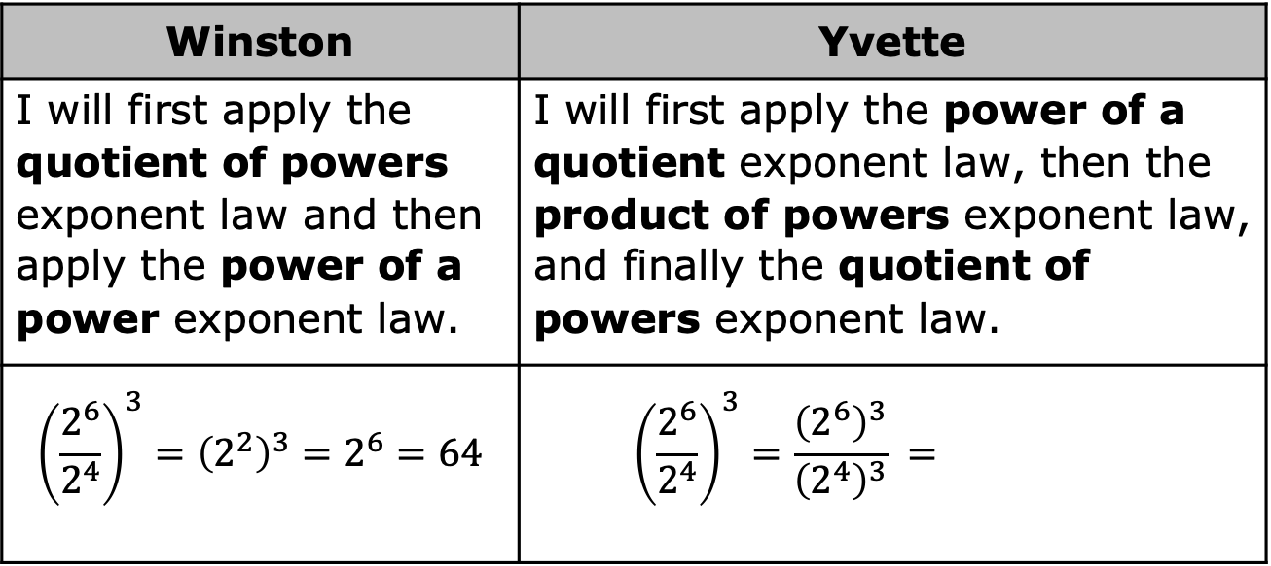
Winston | Yvette
I will first apply the quotient of powers exponent law and then apply the power of a power exponent law. | I will first apply the power of a quotient exponent law, then the product of powers exponent law, and finally the quotient of powers exponent law.
$${\left(\frac{2^{6}}{2^{4}}\right)}^{3}={\left(2^{2}\right)}^{3}=2^{6}=64$$ | $${\left(\frac{2^{6}}{2^{4}}\right)}^{3}=\frac{{\left(2^{6}\right)}^{3}}{{\left(2^{4}\right)}^{3}} =$$
Explain which method you prefer.
Ask your partner which method they prefer. Write their explanation here.
volume 2, pg. 17

Slide 10

Guided Practice
volume 2, pg. 17

Slide 11

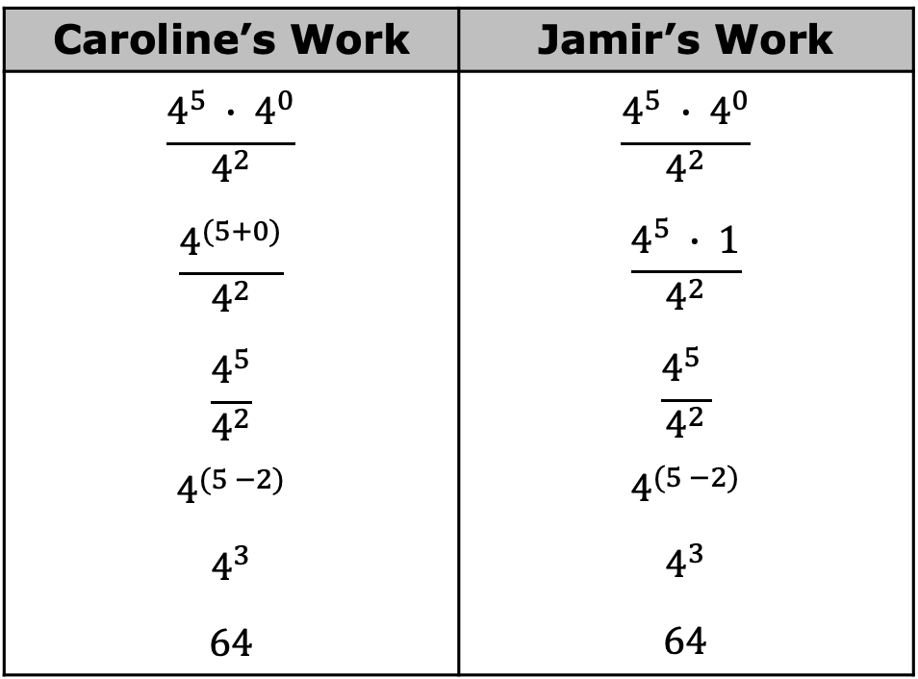
8.3.3 Guided Practice: Writing Equivalent Expressions to Evaluate
Two students evaluated the expression $\frac{4^{5} ∙ 4^{0}}{4^{2}}$ and found its value.
Caroline’s Work | Jamir’s Work
$$\frac{4^{5} ∙ 4^{0}}{4^{2}}$$ $$\frac{4^{(5+0)}}{4^{2}}$$ $$\frac{4^{5}}{4^{2}}$$ $$4^{(5 −2)}$$ $$4^{3}$$ $$64$$ | $$\frac{4^{5} ∙ 4^{0}}{4^{2}}$$ $$\frac{4^{5} ∙ 1}{4^{2}}$$ $$\frac{4^{5} }{4^{2}}$$ $$4^{(5 −2)}$$ $$4^{3}$$ $$64$$
volume 2, pg. 17

Slide 12
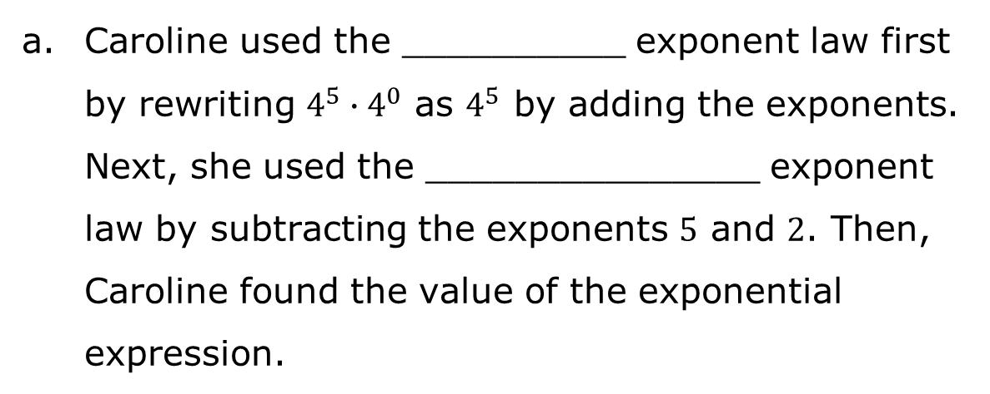
Complete the statements explaining each student’s work by using the phrases from the word bank.
zero
identity
power of a power
product of powers
power of a product
quotient of powers
power of a quotient
Caroline used the __________ exponent law first by rewriting $4^{5}∙4^{0}$ as $4^{5}$ by adding the exponents. Next, she used the _______________ exponent law by subtracting the exponents $5$ and $2$. Then, Caroline found the value of the exponential expression.
volume 2, pg. 17

Slide 13
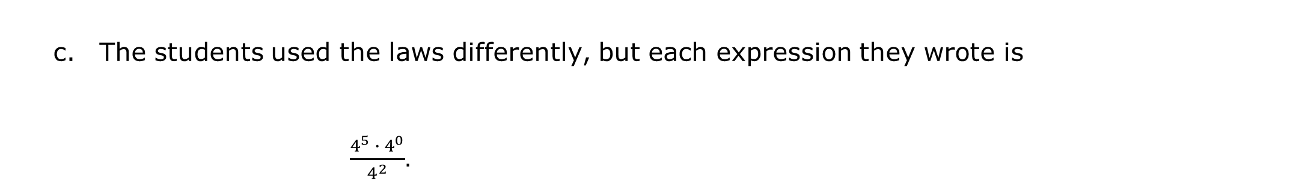
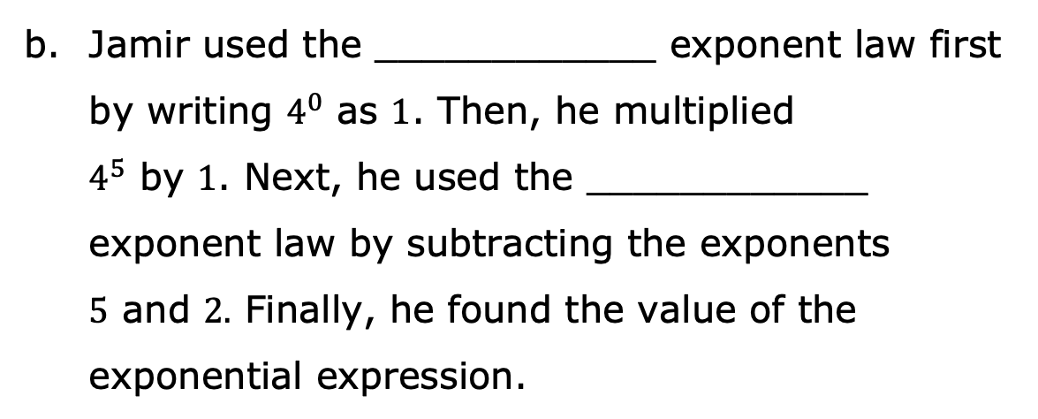
zero
identity
power of a power
product of powers
power of a product
quotient of powers
power of a quotient
Jamir used the ____________ exponent law first by writing $4^{0}$ as $1$. Then, he multiplied $4^{5}$ by $1$. Next, he used the ____________ exponent law by subtracting the exponents $5$ and $2.$ Finally, he found the value of the exponential expression.
The students used the laws differently, but each expression they wrote is $\frac{4^{5} ∙ 4^{0}}{4^{2}}$.
less than
equivalent to
greater than
volume 2, pg. 18

Slide 14
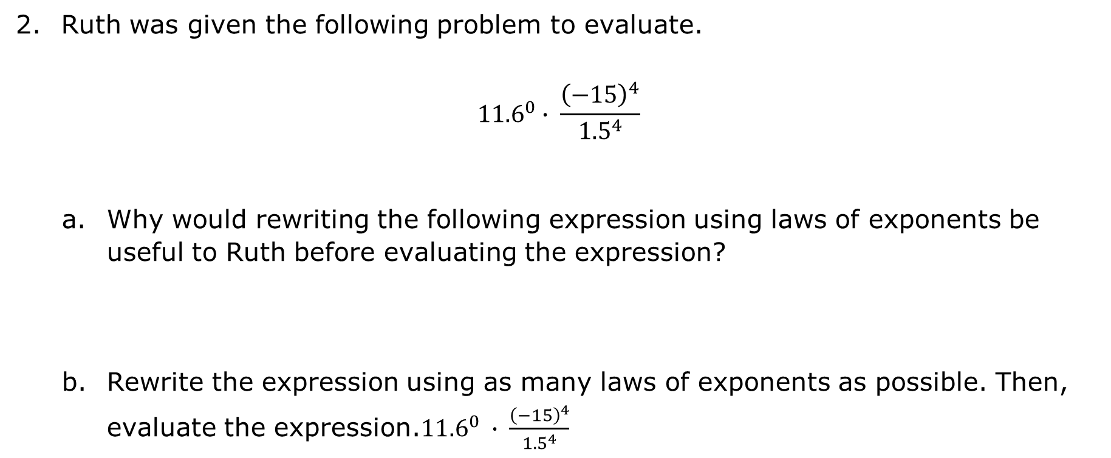
Ruth was given the following problem to evaluate.
$${11.6}^{0}∙ \frac{{\left(−15\right)}^{4}}{{1.5}^{4}}$$
Why would rewriting the following expression using laws of exponents be useful to Ruth before evaluating the expression?
Rewrite the expression using as many laws of exponents as possible. Then, evaluate the expression.${11.6}^{0} ∙ \frac{{\left(−15\right)}^{4}}{{1.5}^{4}}$
volume 2, pg. 18

Slide 15

Activity
volume 2, pg. 19

Slide 16

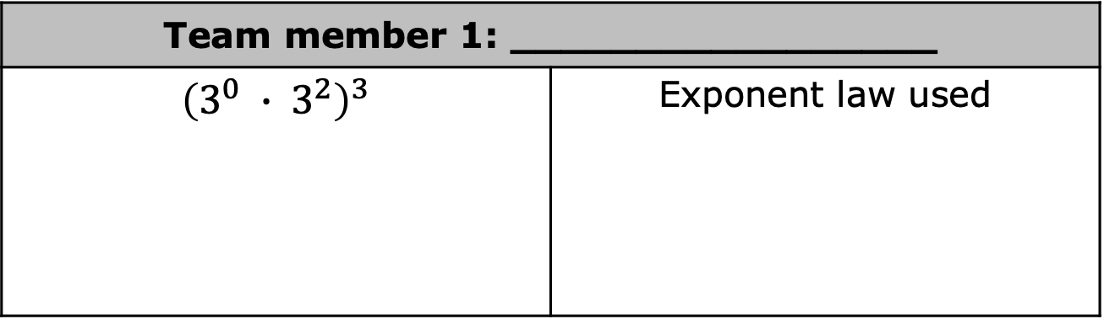
8.3.4 Activity: Roundtable
In teams of three, assign a number to each team member. Each student completes the first step of their problem and writes the exponent law used. Then, pass your problem to the student on your right to check your work and write the next step to the problem. For each new step, continue passing the problems to the student on your right until all three problems are evaluated.
Team member 1: _________________
$${\left(3^{0} ∙ 3^{2}\right)}^{3}$$ | Exponent law used
volume 2, pg. 19

Slide 17
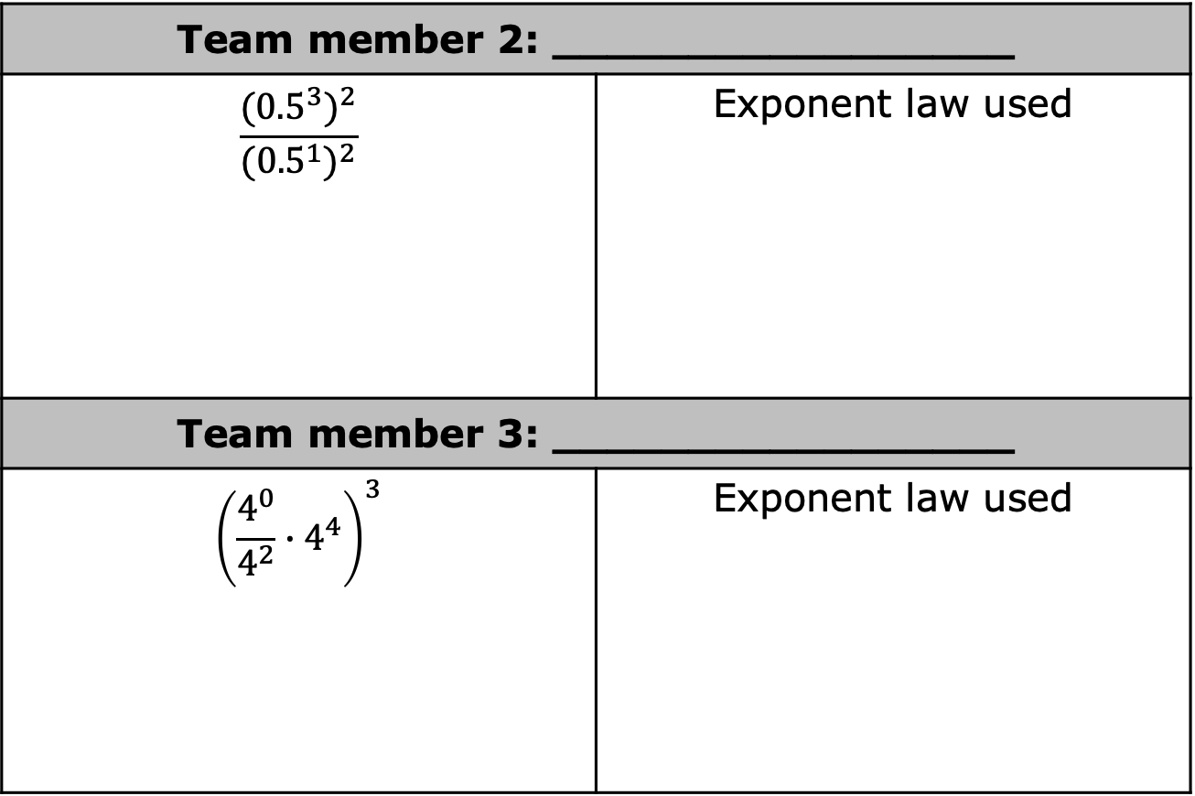
Team member 2: _________________
$$\frac{{({0.5}^{3})}^{2}}{{({0.5}^{1})}^{2}}$$ | Exponent law used
Team member 3: _________________
$${\left(\frac{4^{0}}{4^{2}}∙4^{4}\right)}^{3}$$ | Exponent law used
volume 2, pg. 19

Slide 18

Your Turn
volume 2, pg. 20

Slide 19
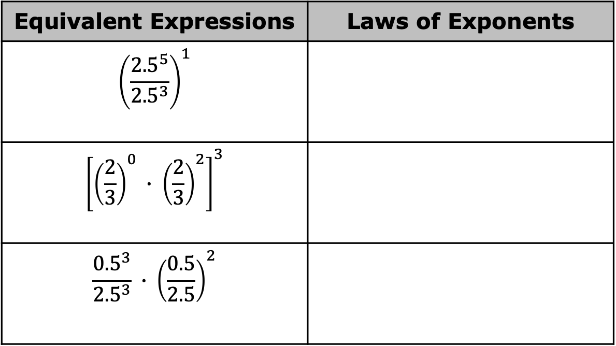
8.3.5 Your Turn!
Use the laws of exponents to evaluate the expressions. Record the law used at each step.
Equivalent Expressions | Laws of Exponents
$${\left(\frac{{2.5}^{5}}{{2.5}^{3}}\right)}^{1}$$
$${\left[{\left(\frac{2}{3}\right)}^{0} ∙ {\left(\frac{2}{3}\right)}^{2}\right]}^{3}$$
$$\frac{{0.5}^{3}}{{2.5}^{3}} ∙ {\left(\frac{0.5}{2.5}\right)}^{2}$$
volume 2, pg. 20

Slide 20

Evaluate each expression showing each step of your work. Use a calculator to verify your solutions.
${\left(\frac{{0.4}^{2}}{{0.4}^{1}}\right)}^{2}$
$\frac{{\left(2^{2} ∙ {3.2}^{0}\right)}^{6}}{2^{10}}$
$\frac{{\left(−4\right)}^{2} ∙ {\left(−4\right)}^{1}}{{\left(−4\right)}^{0}}$
${0.1}^{2} ∙ {\left({0.1}^{1}\right)}^{2}$
$\frac{2.1}{{3.2}^{0}} ∙ {2.1}^{2}$
volume 2, pg. 20

Slide 21

Wrap-Up
volume 2, pg. 21

Slide 22
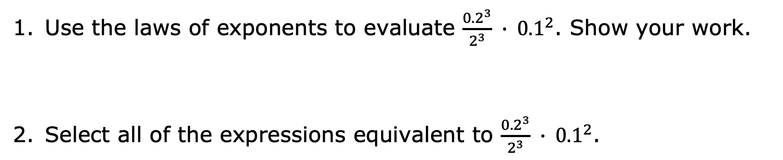
8.3.6 Wrap-Up: Ticket Out the Door
Use the laws of exponents to evaluate $\frac{{0.2}^{3}}{2^{3}} ∙ {0.1}^{2}$. Show your work.
Select all of the expressions equivalent to $\frac{{0.2}^{3}}{2^{3}} ∙ {0.1}^{2}$.
${0.1}^{5}$ | $\frac{{0.2}^{5}}{{0.2}^{3}}$
${0.2}^{0} ∙ {0.1}^{2}$ | ${\left(\frac{0.2}{2}\right)}^{3}∙ {0.1}^{2}$
${0.1}^{3} ∙ {0.1}^{2}$ | ${0.2}^{5}$
volume 2, pg. 21

